Slide 1


Traffic Analysis
Abdullah Altamimi
Saad Alkathiri
Nawaf ALomeir

Slide 2

objective
1
Forecasting trends and future changes
2
Informed decision-making
3
Discovering new trends and patterns

Slide 3




Benefit
Improving everyday life
Improving traffic planning and management
Clear insight of traffic volume

Slide 4
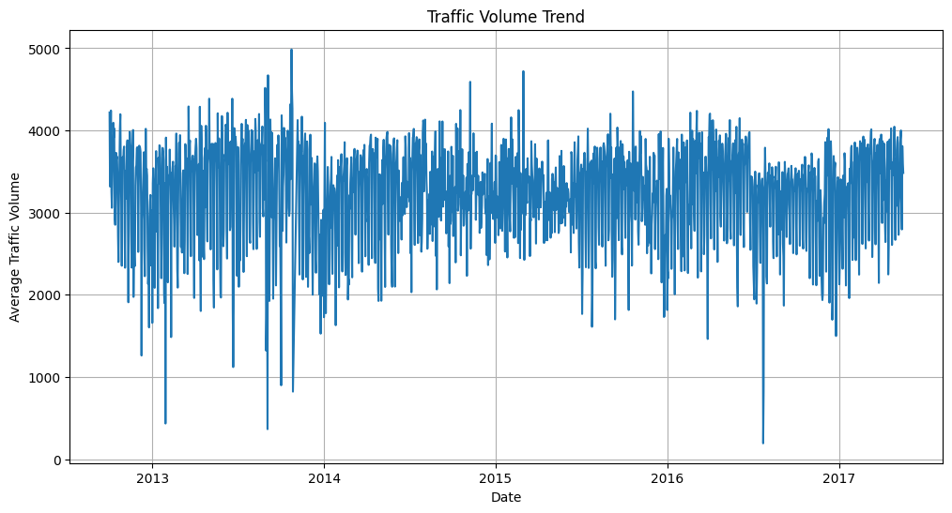
EDA

Slide 5
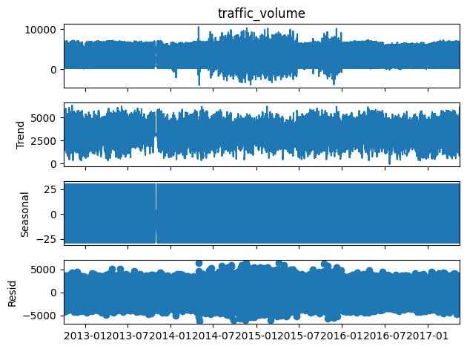
EDA

Slide 6
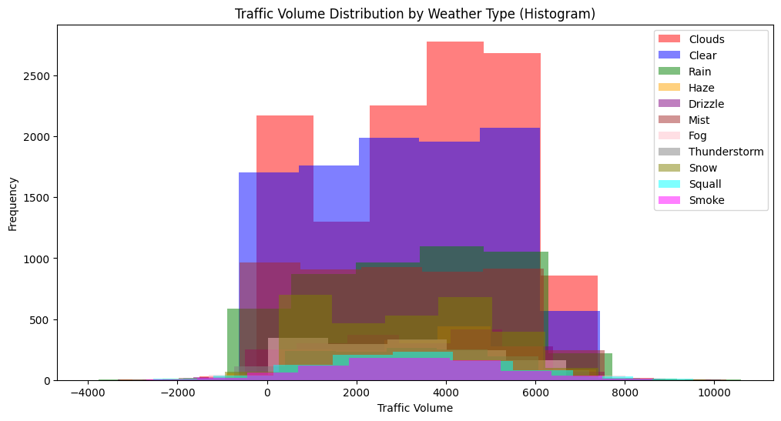
EDA

Slide 7


Database

Slide 8
Models Architecture
4 hidden layers
Tanh activation function
Mean squared error loss function
Output layer

Slide 9
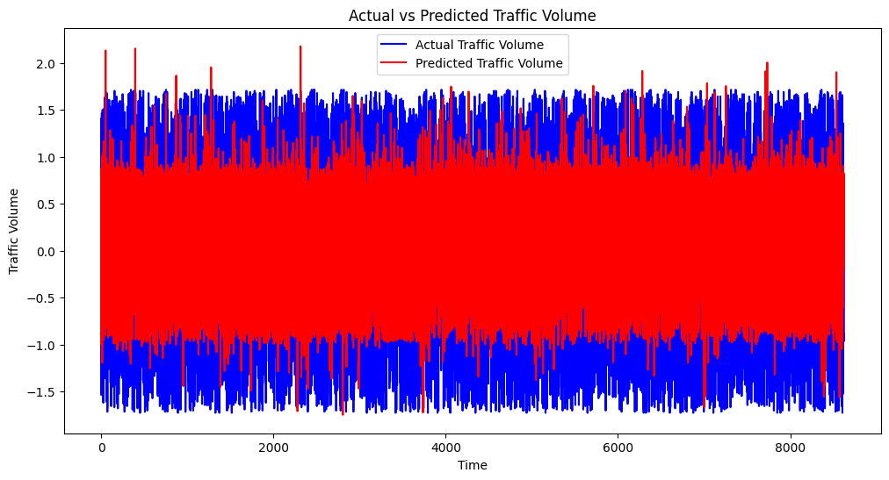
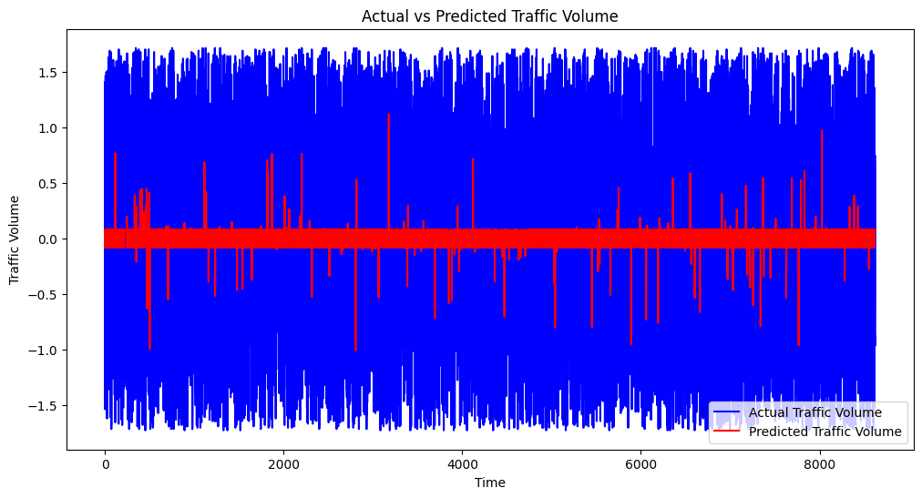
Model

Slide 10
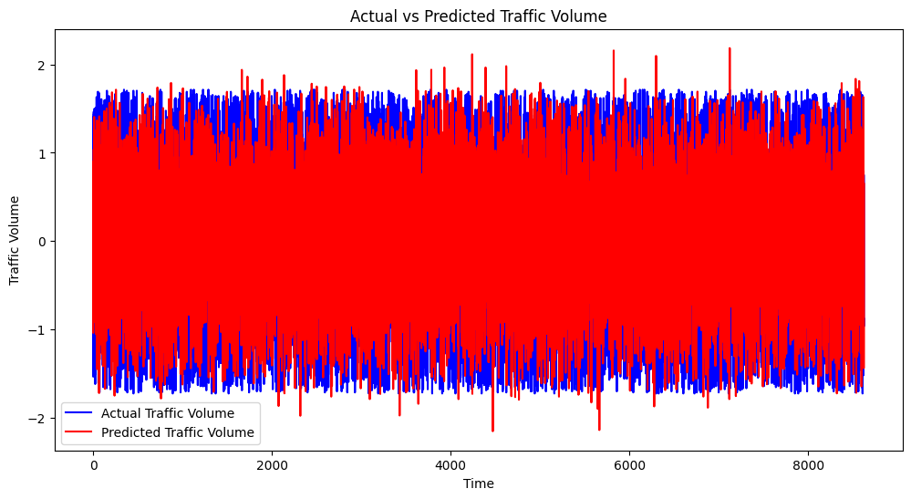
Model

Slide 11

Deployment

